Slide 1
OMIS 308 — PREDICTIVE ANALYTICS | GROUP PROJECT
Predictive Analytics for Global
Real Estate Investment Strategy
A Comparative Study of Accra, Mumbai, and London for ED Happiness Estates
Case study prepared for Miss Osei Abrefi Akoto, CEO, ED Happiness Estates — advising on the deployment of USD 500 million in secured real estate investment capital.
Group Members: Sarah Sally Aidoo · Nyamekye Kessewaa Frempong · Charles Afful · Mohammed Nii Adama Tagoe · Godsway Wedzi · Cathia Eugelene Koumba Kindou

Slide 2
PRESENTATION ROADMAP
Agenda
01
The Brief & Objectives
ED Happiness Estates' investment mandate and our analytical goals
02
City Selection
Why Accra, Mumbai, and London
03
Data & Methodology
Sources, cleaning, feature engineering, modelling approach
04
City-by-City Results
Regression and time-series findings for each market
05
Comparative Discussion
Cross-city predictability and risk gradient
06
Recommendations
Five data-driven recommendations & positioning strategy
ED Happiness Estates — Investment Strategy
2

Slide 3
CASE STUDY CONTEXT
The ED Happiness Estates Brief
$500M
Miss Osei Abrefi Akoto, CEO of ED Happiness Estates, has secured USD 500 million in venture capital funding from 35 investors to develop ultra-modern brutalist residential and commercial buildings for rental and sale.
Secured investment capital
35
Identify the most strategic city (or cities) for a large, long-term real estate investment
Venture capital & global investors
Use real-world, multi-source data to explain what drives housing prices and sales
3 Cities
Accra · Mumbai · London
Deliver defensible, data-driven investment recommendations — not intuition
ED Happiness Estates — Investment Strategy
3

Slide 4
WHAT THIS REPORT DELIVERS
Objectives
1
Select and justify three global cities spanning developed, emerging, and developing economies
2
Collect, clean, and engineer real estate & socio-economic data from multiple reputable sources
3
Build and evaluate at least two regression and two time-series models per requirement
4
Interpret model results to identify the key determinants of price in each market
5
Translate analysis into five well-justified, data-driven investment recommendations
ED Happiness Estates — Investment Strategy
4

Slide 5
SPANNING THE DEVELOPMENT SPECTRUM
Three Cities, Three Economic Stages
Accra
Mumbai
London
Ghana — Developing Economy
India — Emerging Economy
United Kingdom — Advanced Economy
ED Happiness Estates' home market; rapid urbanisation and a growing middle class
India's financial capital; strong GDP growth and heavy investor interest in real estate
Mature, liquid, transparent global financial centre with strong legal protections
ED Happiness Estates — Investment Strategy
5

Slide 6
CITY SELECTION & JUSTIFICATION
Comparative Snapshot
Criterion | Accra | Mumbai | London
Market size | Small, high-growth | Very large, high-growth | Large, mature
Growth potential | High | High | Moderate
Investor interest | Rising, niche | Very high | Consistently high
Economic stability | Moderate | Moderate–High | High
Price predictability (R²) | 0.62 | 0.83 | 0.88
Strategic role | Regional flagship / growth bet | Scale & diversification | Stable anchor / rental yield
ED Happiness Estates — Investment Strategy
6

Slide 7
MULTIPLE REPUTABLE SOURCES
Data Sources
City | Primary Dataset | Size | Key Variables
Accra | Kaggle — Accra residential property listings | 4,320 → 3,917 (Greater Accra) | Price, category, bedrooms/bathrooms, floor area, condition, furnishing, lat/long, locality
Mumbai | Kaggle — Mumbai property sales dataset | 50,000 → ~45,200 (post-cleaning) | Price, locality, market tier, carpet area, BHK, floor, building age, builder, metro proximity
London | UK Government / Kaggle — Housing in London (monthly, by borough) | 13,549 → 7,328 (1995–2020) | Average price, borough, houses sold, recorded crimes, date
Supplemented with contextual socio-economic reasoning from the World Bank Database (GDP growth, urbanisation) and Numbeo (cost-of-living, rent indices), as recommended in the assignment brief.
ED Happiness Estates — Investment Strategy
7

Slide 8
A CONSISTENT ANALYTICAL PIPELINE
Methodology
Data
Understanding
→
Cleaning &
Integration
→
Outlier
Detection
→
Feature
Engineering
→
Model
Building
→
Evaluation &
Interpretation
All analysis conducted in Python — pandas, NumPy, scikit-learn, statsmodels, and pmdarima
Regression models
Time-series models
Ordinary Least Squares Linear Regression (baseline) plus a regularised counterpart — Lasso (Accra) or Ridge (Mumbai, London) — to test robustness to multicollinearity among one-hot-encoded location dummies.
Simple Moving Average (all 3 cities) as a naive benchmark, plus auto-ARIMA (Accra, Mumbai, via stepwise AIC minimisation) and Holt's trend-adjusted Exponential Smoothing (London).
All features standardised (z-scored); 80/20 train–test split (random_state = 42) for out-of-sample evaluation via R², MAE, RMSE, and MAPE.
ED Happiness Estates — Investment Strategy
8

Slide 9
PREPARING THE DATA FOR MODELLING
Cleaning, Outliers & Feature Engineering
Data Cleaning & Integration
Outlier Detection & Feature Engineering
• Checked for missing values and duplicate records in each dataset
• IQR method used to detect outliers; Accra values capped (not deleted) to preserve sample size
• Filtered to correct metropolitan boundaries (e.g., Greater Accra; valid London boroughs)
• Accra: price/m², bedroom-to-bathroom ratio, distance from CBD (km), ordinal + one-hot encoding
• Parsed dates into year/month features
• Mumbai: property age, numeric BHK count, target encoding of locality/builder/metro station
• Removed logically inconsistent records — e.g. 4,793 Mumbai rows (9.6%) with impossible floor/build-year values
• London: year/month from date, one-hot borough encoding, median imputation for houses sold
• Dropped target-leakage columns (e.g., Mumbai price-per-sqft, INR price)
ED Happiness Estates — Investment Strategy
9

Slide 10
ANALYSIS & RESULTS
Accra, Ghana
Developing Economy — ED Happiness Estates' Home Market
ED Happiness Estates — Investment Strategy
10

Slide 11
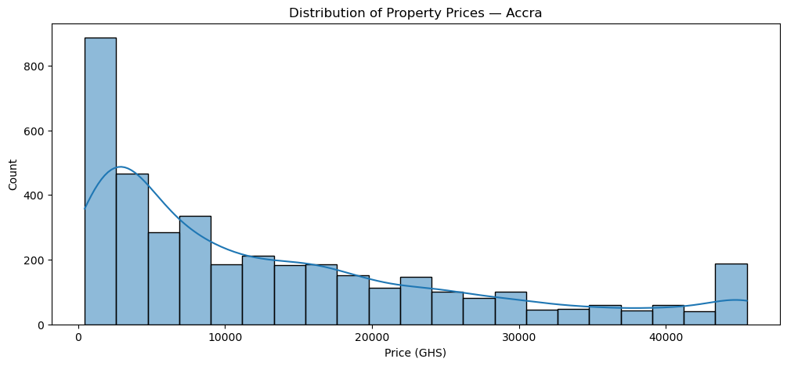
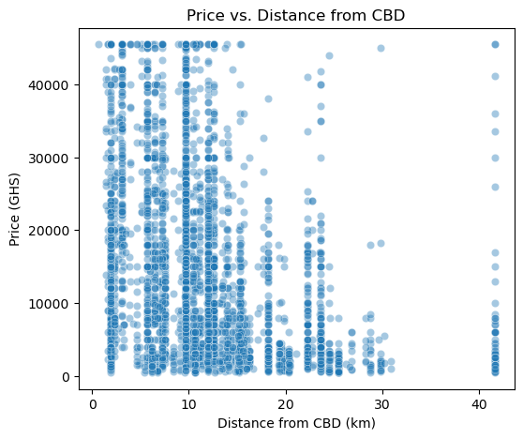
ACCRA — DATA UNDERSTANDING
Price Distribution & Central Business District Effect
Figure 1. Distribution of property prices in Greater Accra (post outlier-capping).
Figure 2. Property price vs. distance from Accra CBD — a visible negative relationship.
3,917
GHS 13,039
GHS 8,000
Listings after filtering
Average listed price
Median listed price
ED Happiness Estates — Investment Strategy
11

Slide 12
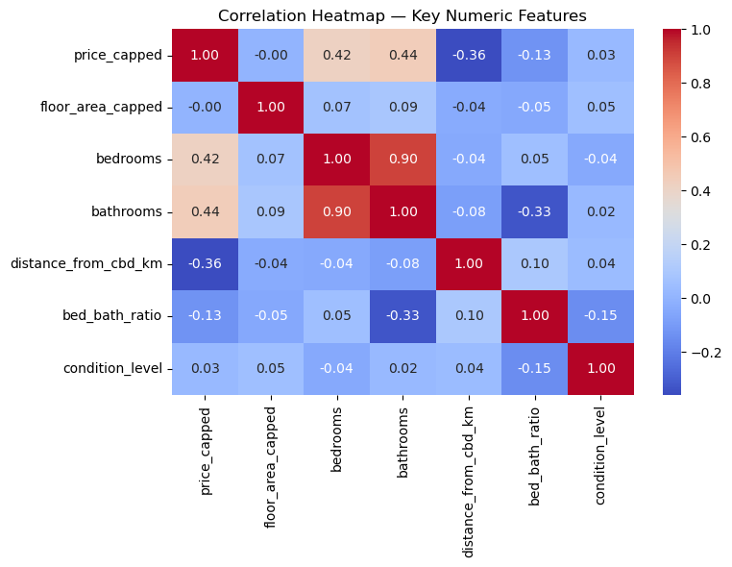
ACCRA — REGRESSION MODELLING
Explaining Price Variation
Model | R² | MAE (GHS)
Linear Regression | 0.623 | 6,029
Lasso Regression (α = 50) | 0.623 | N/A
R² ≈ 0.62 indicates observable property characteristics explain a meaningful majority — but not the overwhelming bulk — of price variation in Accra. This is consistent with a developing real-estate market where informal negotiation, title/legal status, and off-market factors are not captured in the data.
Figure 3. Correlation heatmap of key numeric features against capped property price.
Strongest predictors: floor area, bedrooms/bathrooms, condition, distance from CBD, locality.
ED Happiness Estates — Investment Strategy
12

Slide 13
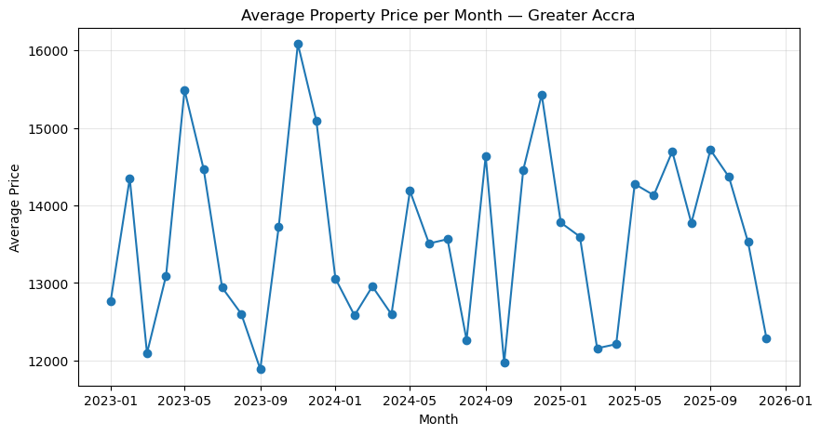
ACCRA — TIME-SERIES FORECASTING
Monthly Price Movement
Model | MAE | RMSE | MAPE
3-Month SMA | GHS 1,564 | GHS 1,702 | 10.95%
ARIMA(0,0,0)(0,0,0)[12]+c | N/A | N/A | AIC = 610.1
An Augmented Dickey-Fuller test strongly rejected non-stationarity, but only 36 months of data were available, and the selected ARIMA specification found no exploitable trend or seasonal structure — the series behaves close to random noise around its mean.
Figure 4. Average monthly property price, Greater Accra.
Takeaway: near-term price forecasts for Accra should be treated as indicative only.
ED Happiness Estates — Investment Strategy
13

Slide 14
ANALYSIS & RESULTS
Mumbai, India
Emerging Economy — Scale & Growth at Volume
ED Happiness Estates — Investment Strategy
14

Slide 15
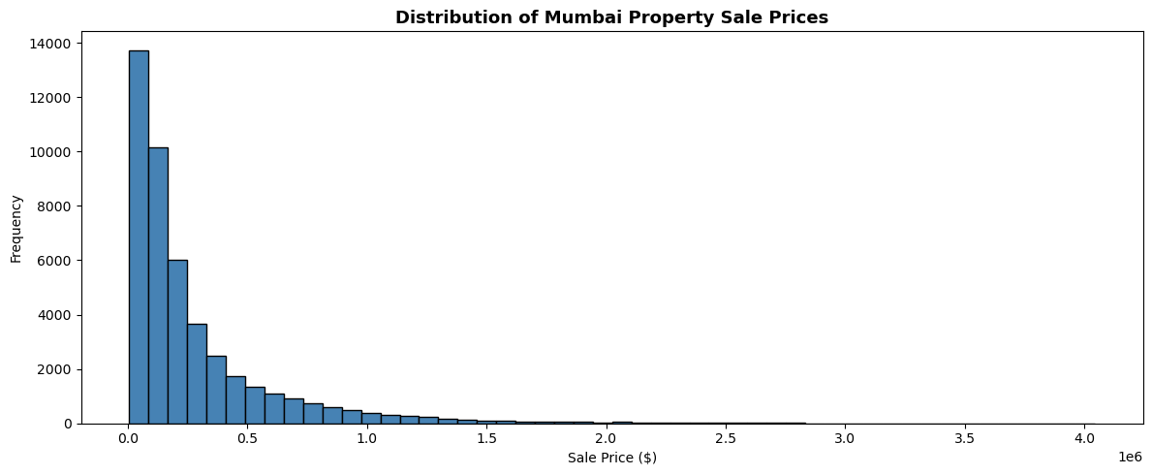
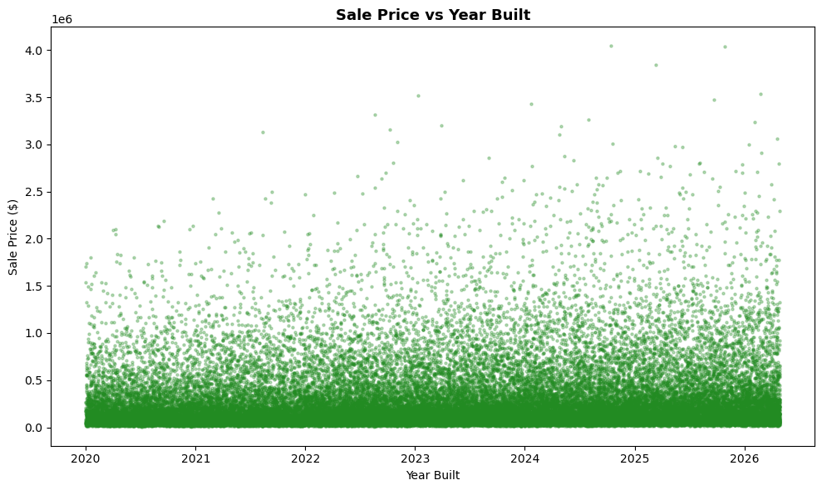
MUMBAI — DATA UNDERSTANDING
Price Distribution & Market Trend
Figure 5. Distribution of Mumbai property sale prices (USD).
50,000
~45,200
Raw listings, 32 fields
Listings after cleaning
Figure 6. Sale price vs. listing date — dispersion and upward drift over time.
9.6% removed
Logically inconsistent records (floor > total floors, build year post-dates listing)
ED Happiness Estates — Investment Strategy
15

Slide 16
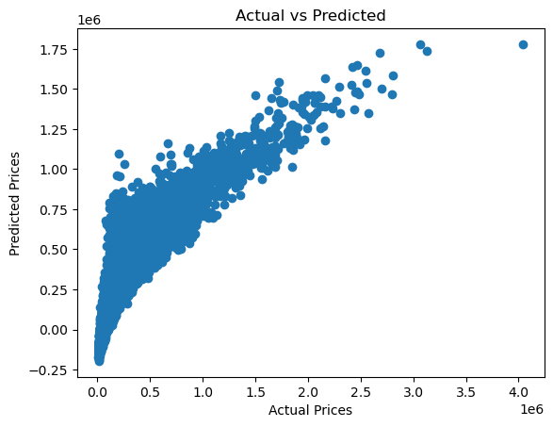
MUMBAI — REGRESSION MODELLING
Explaining Price Variation at Scale
Model | R² | MAE (USD)
Linear Regression | 0.826 | 81,769
Ridge Regression (α = 1.0) | 0.826 | N/A
R² = 0.826 — a strong fit driven by the very large sample size (45,000+ listings). Ridge regression confirms robustness, producing a virtually identical R², indicating multicollinearity among location dummies is not distorting the baseline model.
Figure 7. Actual vs. predicted Mumbai sale prices (Linear Regression, test set).
Strongest predictors: carpet/built-up area, market tier, locality/builder premium, metro proximity, property age.
ED Happiness Estates — Investment Strategy
16

Slide 17
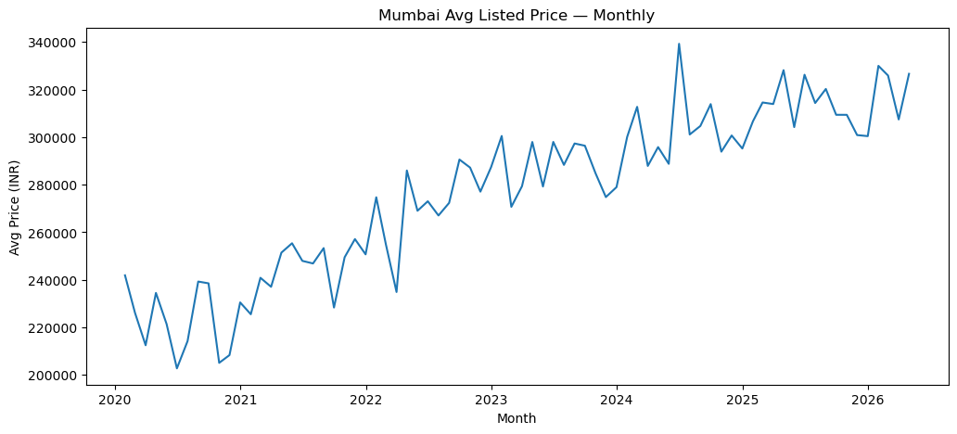
MUMBAI — TIME-SERIES FORECASTING
A Persistent Upward Trend
Augmented Dickey-Fuller Test | Statistic | p-value | Conclusion
Price level | -2.70 | 0.073 | Non-stationary (trend)
First difference | -7.36 | <0.001 | Stationary
Non-stationary in levels, stationary after differencing — Mumbai exhibits a genuine, statistically-confirmed upward price trend rather than noise, but historical growth rates may not continue linearly given macro shocks (interest rates, RERA regulatory shifts).
Figure 8. Average monthly Mumbai listing price.
ED Happiness Estates — Investment Strategy
17

Slide 18
ANALYSIS & RESULTS
London, United Kingdom
Advanced Economy — Stability & Predictability
ED Happiness Estates — Investment Strategy
18

Slide 19
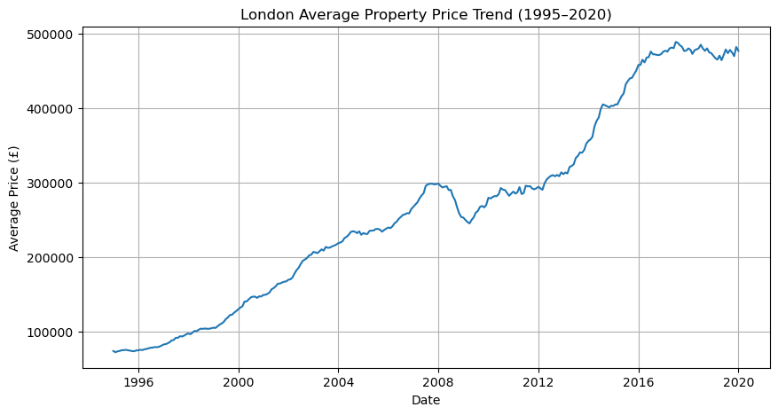
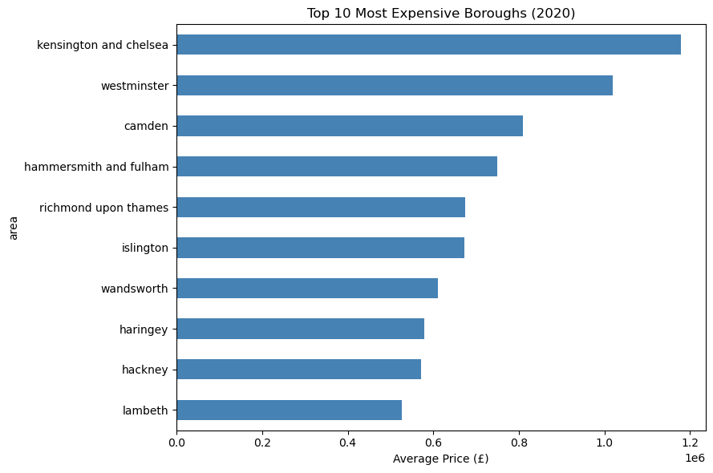
LONDON — DATA UNDERSTANDING
A Quarter-Century Price Trend
Figure 9. London average property price trend, 1995–2020 (city-wide series).
Figure 10. Top 10 most expensive London boroughs (latest year available).
Persistent appreciation since 1995, with a brief plateau around the 2008–2009 global financial crisis — confirming London's status as a long-run capital-appreciation market.
ED Happiness Estates — Investment Strategy
19

Slide 20
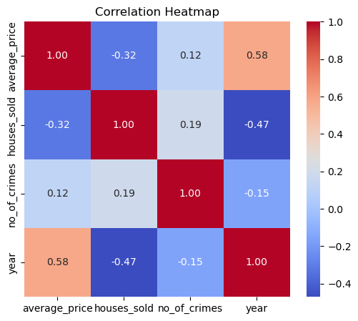
LONDON — REGRESSION MODELLING
The Strongest Fit of the Three Cities
Model | R² | RMSE (£) | MAE (£)
Linear Regression | 0.885 | 64,508 | 46,394
Ridge Regression (α = 10) | 0.885 | 64,480 | 46,277
R² = 0.885 — the strongest regression fit of the three cities. Borough identity alone, combined with houses sold and crime rate, explains the large majority of price variation — consistent with London's maturity, transparency, and data richness.
Figure 11. Correlation heatmap: price, houses sold, crimes, and year.
Strongest predictors: borough identity, houses sold, recorded crime rate.
ED Happiness Estates — Investment Strategy
20

Slide 21
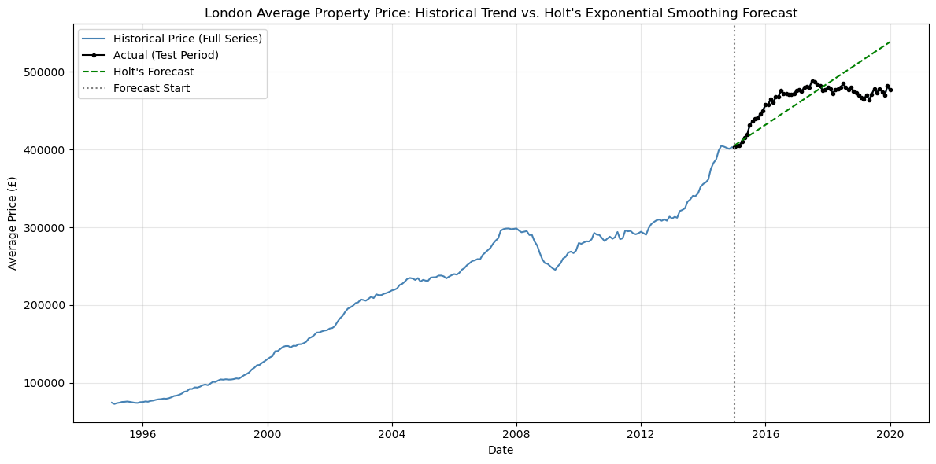
LONDON — TIME-SERIES FORECASTING
Trend-Aware Modelling Wins Decisively
Model | MAE (£) | RMSE (£) | MAPE
3-Month SMA | 62,606 | 66,289 | 13.27%
Holt's Exp. Smoothing | 23,841 | 29,377 | 5.08%
Holt's method cuts MAPE from 13.27% to 5.08% — confirming London's price series is dominated by a persistent, well-behaved upward trend rather than noise. A flat SMA structurally lags such a trend; Holt's, which explicitly models trend, tracks it closely.
Figure 12. Holt's Exponential Smoothing forecast vs. actual (test period).
ED Happiness Estates — Investment Strategy
21

Slide 22
CROSS-CITY SYNTHESIS
Comparative Discussion
Metric | Accra | Mumbai | London
Best regression R² | 0.623 (Linear/Lasso) | 0.826 (Linear/Ridge) | 0.885 (Ridge)
Best time-series MAPE | 10.95% (SMA) | n/a (ARIMA, differenced) | 5.08% (Holt's)
Price series behaviour | Stationary, noise-like | Trending, non-stationary | Strong persistent trend
Sample size (post-cleaning) | 3,917 | ~45,200 | 7,328 (borough-months)
Investment character | High growth, higher uncertainty | Scale & appreciation, moderate uncertainty | Stability & liquidity, lower uncertainty
A clear gradient from less to more predictable — and from higher-growth/higher-risk to lower-growth/lower-risk — maps closely onto each city's stage of economic development. This is economically intuitive, not a modelling artefact.
ED Happiness Estates — Investment Strategy
22

Slide 23
WHAT THE MODELS DON'T CAPTURE
Risks & Limitations
Accra
Mumbai
London
• 38% of price variation unexplained (R² = 0.62)
• Non-stationary trend — historical growth may not continue linearly
• High entry cost, lower % growth vs. Accra/Mumbai
• Only 36 months of time-series data; no exploitable trend found
• High market segmentation masks micro-market dynamics
• Dataset ends 2020 — post-pandemic & rate shifts not reflected
• Currency (GHS) and land-title complexity add execution risk
• 9.6% data removed; target encoding risks overfitting
• Borough averages obscure street-level, micro-location risk
Cross-cutting: datasets differ in currency/period (not apples-to-apples on price levels); no macro-economic indicators included; models assume historical price relationships hold for a novel brutalist-architecture product category.
ED Happiness Estates — Investment Strategy
23

Slide 24
FIVE DATA-DRIVEN RECOMMENDATIONS
Recommendations (1 of 2)
1
Adopt a three-city, risk-tiered capital allocation strategy, anchored by London
London's superior predictability (R² = 0.885; Holt's MAPE = 5.08%) justifies the largest single-city allocation as a stable, long-duration anchor.
2
Deploy a growth-oriented tranche to Mumbai, prioritising mid-to-premium tier near metro infrastructure
R² = 0.826 with a confirmed statistical upward trend supports scale-oriented deployment in Mumbai's most liquid, well-connected segments.
3
Enter Accra with a smaller, phased tranche in high-value, CBD-proximate localities
Distance from CBD shows a clear negative relationship with price; a phased approach manages the wider uncertainty (R² = 0.62).
ED Happiness Estates — Investment Strategy
24

Slide 25
FIVE DATA-DRIVEN RECOMMENDATIONS
Recommendations (2 of 2)
4
Match strategy to each city's demonstrated demand driver
Rental-led in London (predictable appreciation, strong tenant demand); mixed sales/rental in Mumbai (tiered demand); sales-led in Accra (capital efficiency in a phased-entry market).
5
Use each city's best-performing forecasting model to time phased capital releases
Holt's forecasts should directly pace deployment in London given demonstrated accuracy (MAPE 5.08%); Accra and Mumbai releases should be more conservative, reinvesting in data collection to progressively de-risk both markets.
ED Happiness Estates — Investment Strategy
25

Slide 26
HOW ED HAPPINESS ESTATES SHOULD SHOW UP
Positioning Summary
City | Recommended Role | Primary Product Focus | Priority
London | Stable anchor / cash-flow core | Rental: premium/luxury residential | Largest allocation
Mumbai | Growth & scale | Mixed sales + rental: mid-to-premium, metro-proximate | Second-largest allocation
Accra | Regional flagship / phased growth bet | Sales-led: high-value CBD-proximate localities | Smallest, phased allocation
Largest
2nd Largest
Phased
London — rental yield anchor
Mumbai — growth & scale
Accra — flagship growth bet
ED Happiness Estates — Investment Strategy
26

Slide 27
CONCLUSION
Not a single winner — a complementary, risk-tiered portfolio
Using a consistent predictive-analytics pipeline, we built and evaluated six regression models and five time-series models across Accra, Mumbai, and London — well exceeding the assignment's minimum of four.
London
Mumbai
Accra
Stable, highly forecastable anchor for rental income
Large-scale growth engine with a confirmed upward trend
Regional flagship market, pursued through phased, disciplined entry
ED Happiness Estates — Investment Strategy
27

Slide 28
SOURCES & TEAM
References & Group Members
References (APA)
Group Members
Hyndman, R. J., & Athanasopoulos, G. (2021). Forecasting: Principles and practice (3rd ed.). OTexts.
Sarah Sally Aidoo
Kaggle (n.d.). Accra Ghana residential property listings dataset; Mumbai property sales dataset; Housing in London monthly borough dataset.
Nyamekye Kessewaa Frempong
Numbeo (2026). Cost of living and property price index by city.
Charles Afful
Pedregosa et al. (2011). Scikit-learn: Machine learning in Python. JMLR, 12, 2825–2830.
Mohammed Nii Adama Tagoe
Seabold, S., & Perktold, J. (2010). Statsmodels: Econometric and statistical modeling with Python.
Godsway Wedzi
UK Government (n.d.). HM Land Registry UK House Price Index. GOV.UK.
Cathia Eugelene Koumba Kindou
World Bank (2026). World development indicators.
ED Happiness Estates — Investment Strategy
28

Slide 29
Thank You
Questions & Discussion
OMIS 308: Predictive Analytics — University of Ghana Business School

